Slide 1
Virtual Pop-Up Session NSF Recent Updates
Zoom – September 24, 2020 Office of Research Services
Presenters:
Jim Clavin, Associate Director, Post-Award
Missy Peloso, Associate Vice Provost/Associate Vice President
Carolyn Poerio, Director, Pre-Award Services

Slide 2
Phasing out FastLane
Fastlane will be sunsetting by 2022

Slide 3
Recent NSF Audit – Reminders
Prior Approvals
Subcontracts
Participant Support Costs – re-budgeting
Admin Costs not included in Budget
Modify/Changes in approved Cost Share/Match
Documentation and Allocation of Expenses
Timely Effort Certification
Admin Salary/Costs not included within original Budget
Maintain Period of Performance Activity

Slide 4
2020 PAPPG Enforcement Begins
Starting October 5, NSF will be enforcing 2020 PAPPG
No longer a requirement to provide reason for requesting exclusion of a potential reviewer
Conference proposals require inclusion of complaint submission and resolution process as well as code of conduct for participants
30 Day prior notification of changes of/ effort changes of PD/PI (30 days in advance generally)
Format changes for biosketch/current and pending

Slide 5
Format Changes Biosketch/Current & Pending
Biosketch to include all titled academic, professional or institutional positions whether or not renumeration is received.
Current and Pending to include all resources made available to an individual in support of his/her research efforts regardless of whether or not they have monetary value.
Format must also be used to update current support on RPPRs
NSF FAQs on Current & Pending

Slide 6
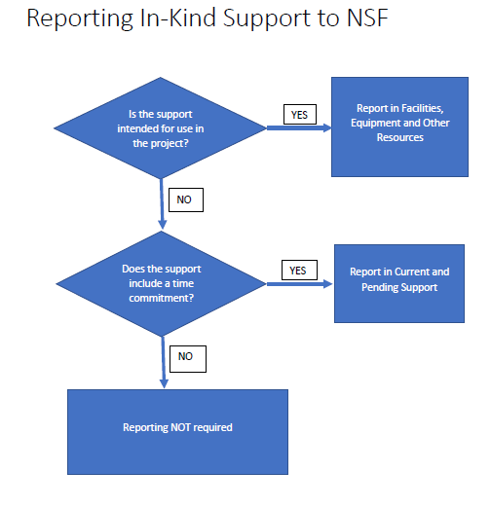

Slide 7
New Required Formats
NSF will only accept biosketches and Current & Pending Support in two formats, SciENcv generated or a version using an NSF fillable PDF.
The NSF-approved fillable PDF Biosketch: https://www.nsf.gov/bfa/dias/policy/biosketch.jsp.
The NSF-approved fillable PDF Current & Pending: https://www.nsf.gov/bfa/dias/policy/cps.jsp.
SciENcv is trending towards industry standard.

Slide 8
How SciENcv works
SciENcv Extracts
IDs
Name
Affiliations
Education
Honors
Awards
Publications
Collaborators
patents
Researcher Provides
Personal Statement
Contributions to science
SciENcv Generates
NSF Biosketches NSF Current & Pending
NIH Biosketches
IES Biosketches
Existing Sources
ORCID
Research.gov
eRA Commons
NCBI My Bibliography

Slide 9
Basic Steps
Login to My NCBI, click on SciENcv
Choose Create a New Document and name it - From Scratch - From an Existing Source - From an Existing Document
Select the Type of Document (NSF Bio or C&P, NIH, IES)
Edit information in SciENcv.
Download the file and upload into proposal system.

Slide 10
Resources
My NCBI Education on SciENcv - https://www.ncbi.nlm.nih.gov/books/NBK154494/
More information on ORCID – www.orcid.org
NSF Biosketches Website: https://www.nsf.gov/bfa/dias/policy/biosketch.jsp
NSF Current & Pending Website: https://www.nsf.gov/bfa/dias/policy/cps.jsp
Penn Biomedical Library: Manuel de la Cruz Gutiérrez, PhD, MLS dmanuel@pobox.upenn.edu

Slide 11
Follow-Up Questions
Do you have a sample of the new C&P document?
The new C&P documents don’t look different, rather they allow NSF to extract data in an XML format and NSF has clarified expectations around content. See NSF C&P link on Resources page.
The names of the two prohibited Chinese telecommunications manufacturers that Missy mentioned:
Huawei
ZTE
Are there limits on the number of people a PI can delegate in SciENcv?
There is no limit on the number of delegates.

